Slide 1
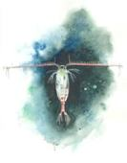
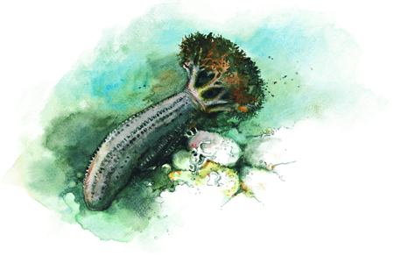
Predict age from Greenland Halibut,
cod otoliths and salmon scales using Convolutional Neural Networks
Endre Moen
Mars 2021
ML-status meeting

Slide 2
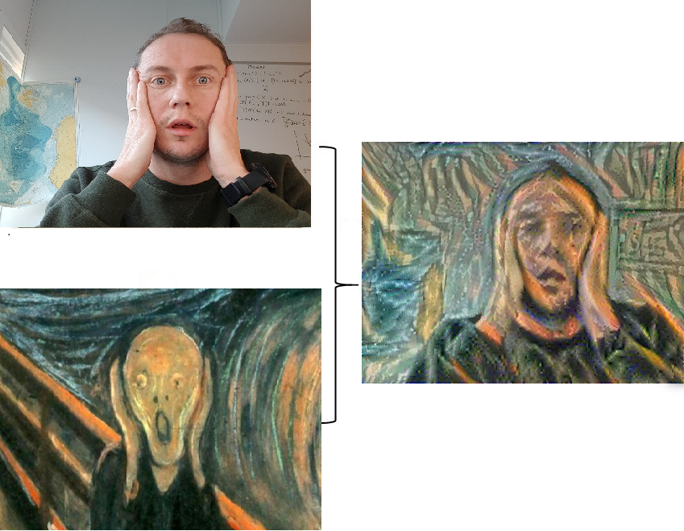
Who am I
Software developer @ HI digital
Background: Computer Science
Notes:
2 slides, Meg, NMD, Instituttet, Web-utvikler perspektiv
<number>

Slide 3
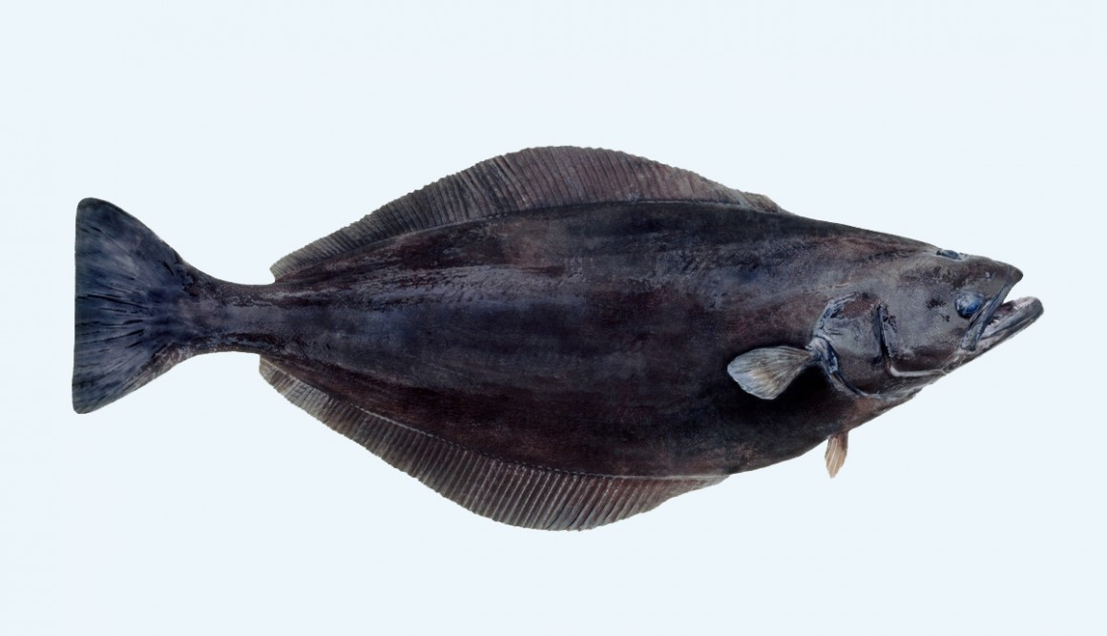
Otoliths: Greenland Halibut (Ørestein:Blåkveite)

Slide 4
Raw-data format
-Age- 11
8 5

Slide 5
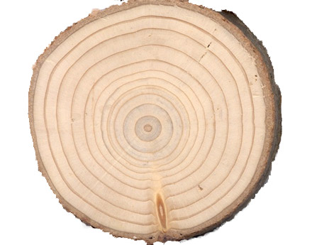
Tree rings

Slide 6
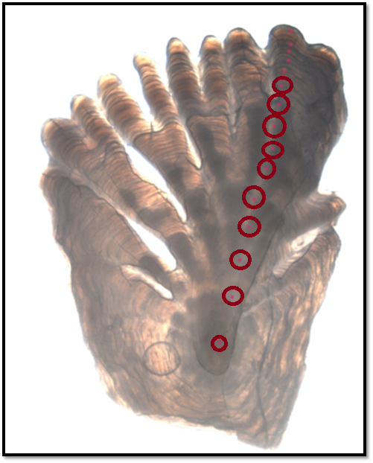
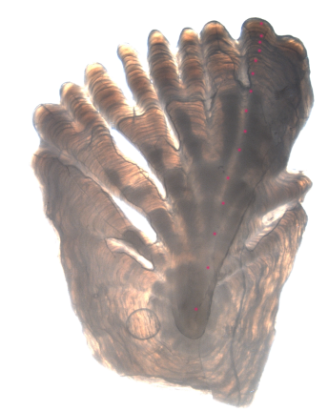
14 years

Slide 7
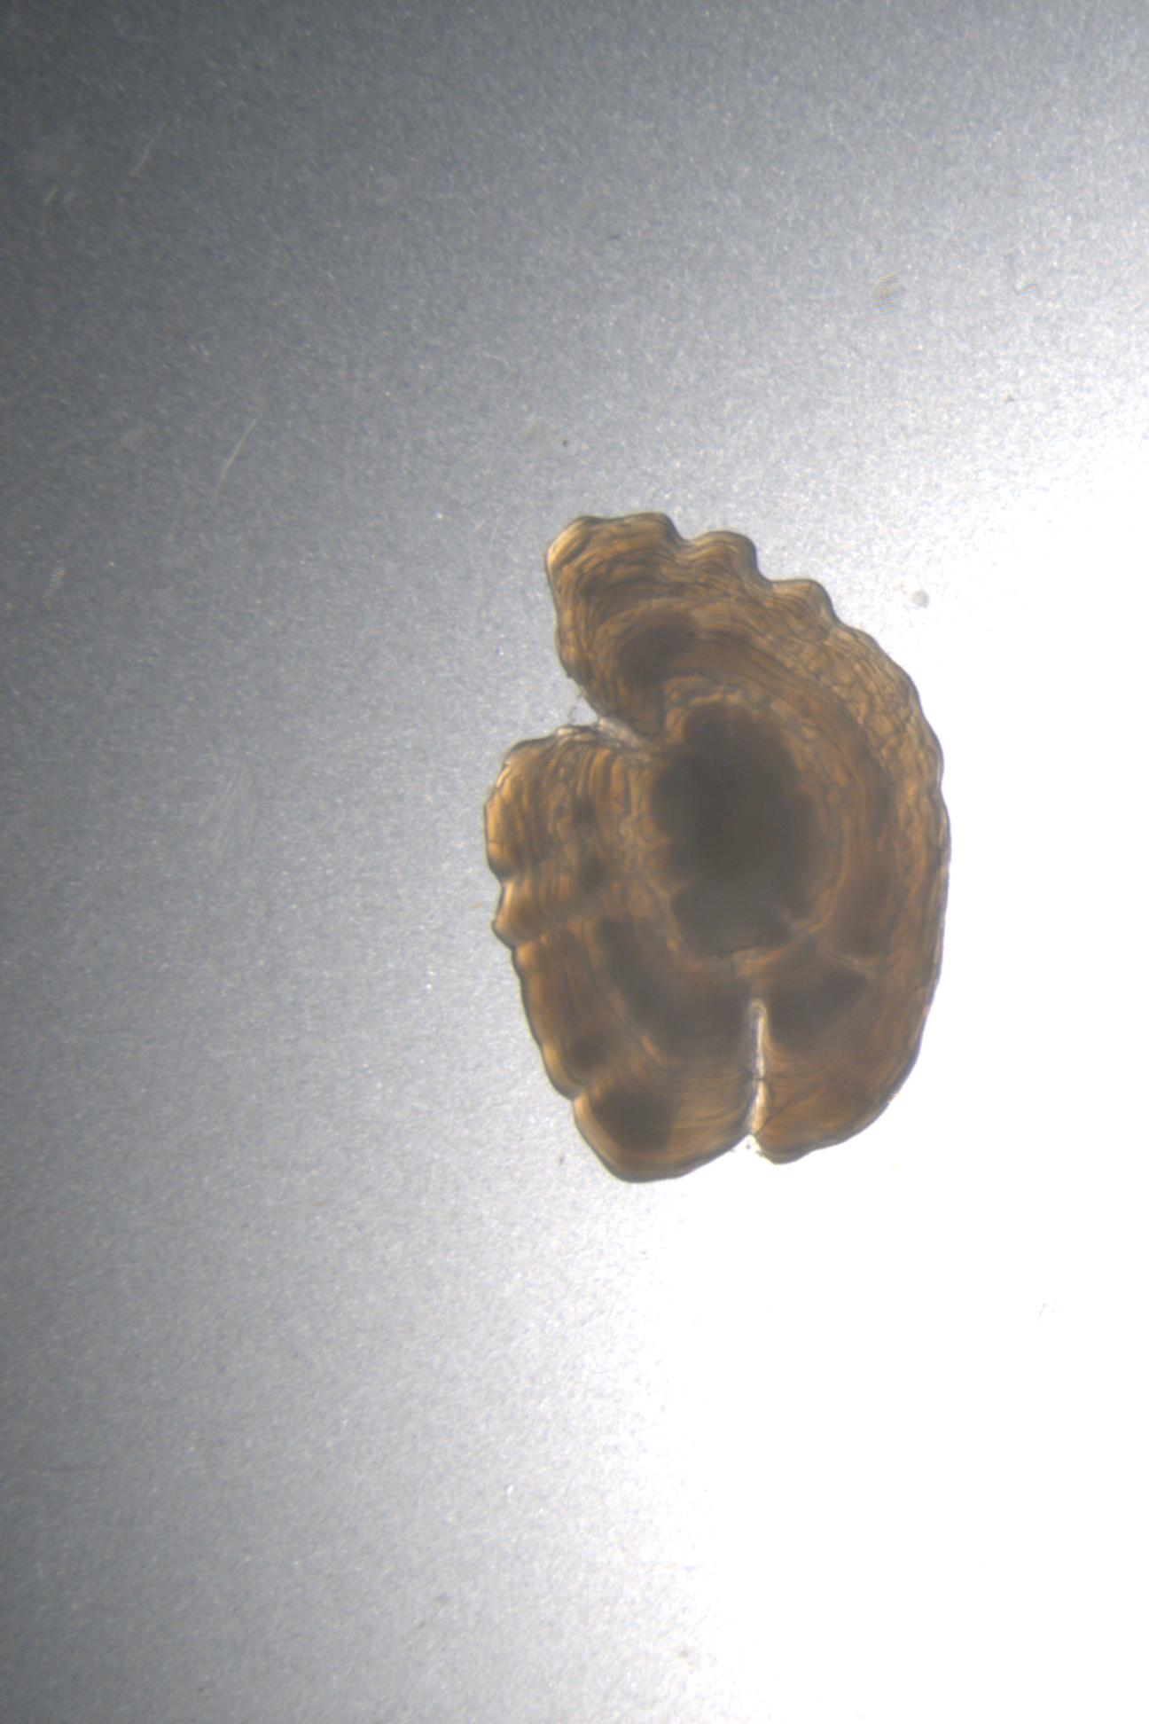
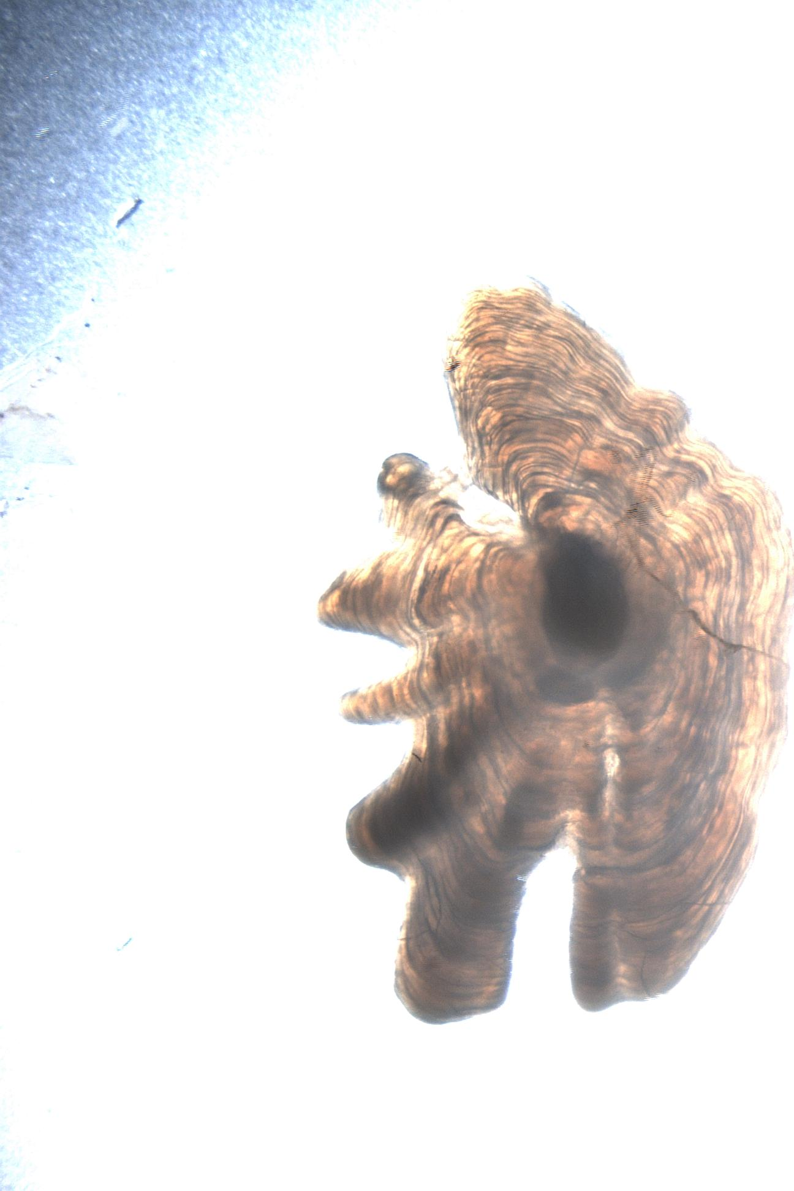
Any Questions?
Predicted: 5.39, 11.72, Age by Expert: 4, 12

Slide 8
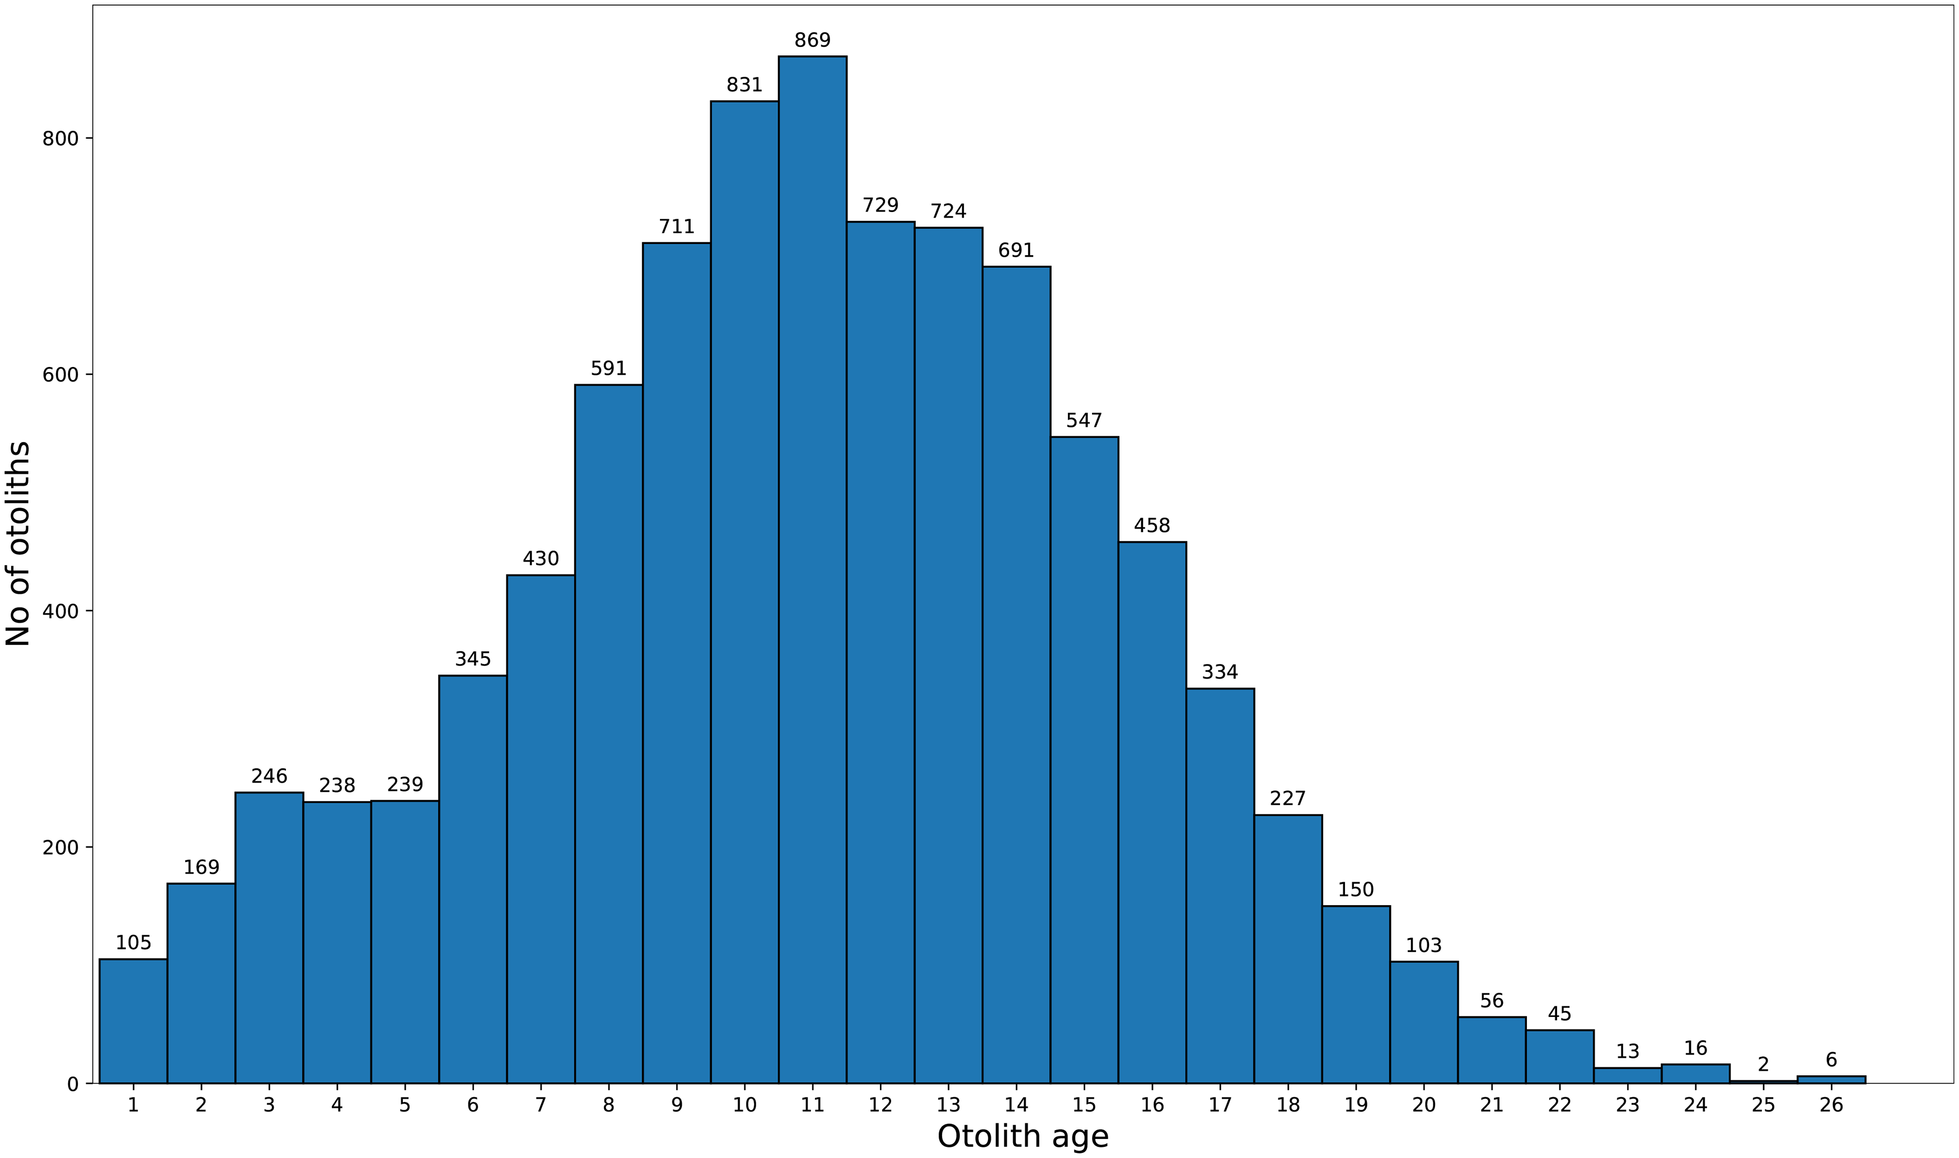
Dataset - 8875

Slide 9
Data Augmentation
Rotate image 360 degrees
Reflect image
The network is invariant to rotation/ reflection (or affine transformations)
Augmented: 8875*360*2 > 5 million possibilities
Loss function: mean squared error

Slide 10
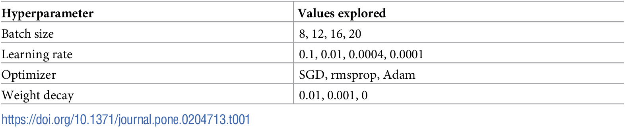

Slide 11
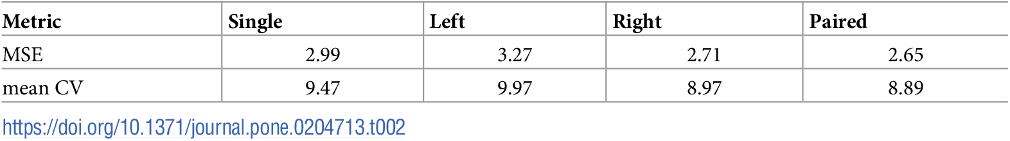
Results
“Mean CV between human experts has previously been reported as 12% and 16.3%” [ref: ICES workshops]

Slide 12
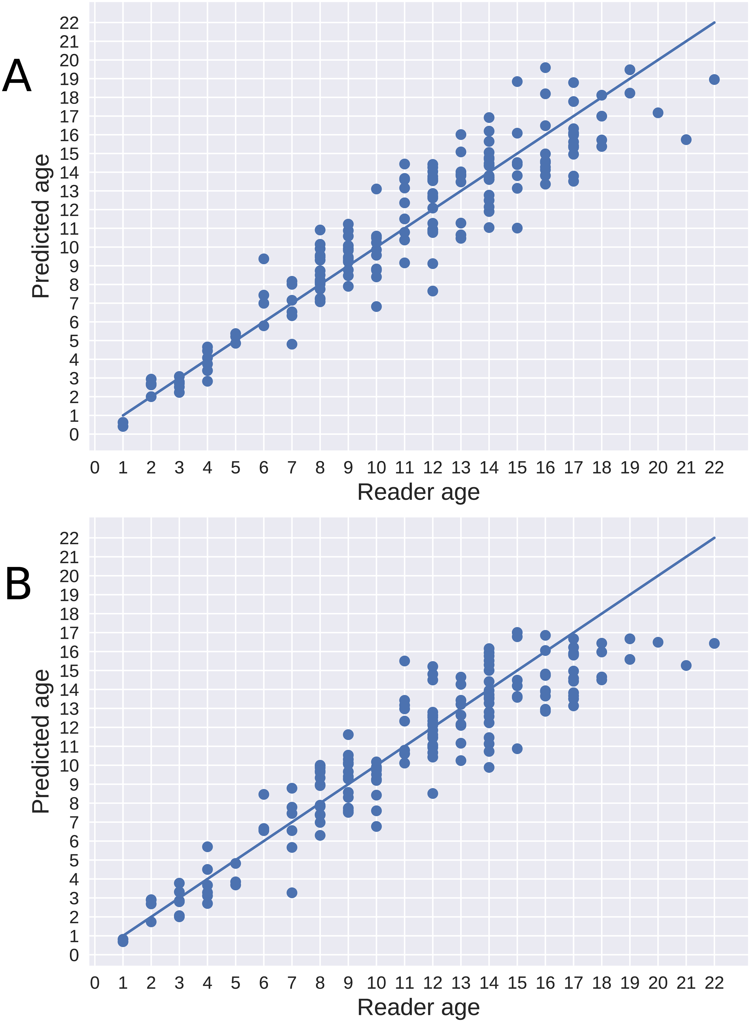
right (A) and left (B)

Slide 13
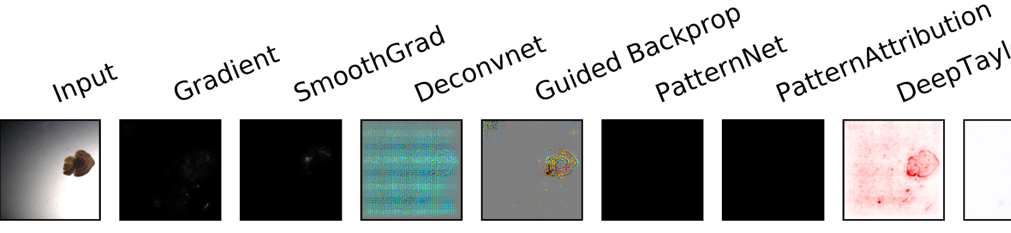
regression activation mappings
The output of the regression model is read as the logit output of a classifier (or ‘model_wo_softmax’ in the code), i.e. the output right before applying softmax function for a classifier.
“Sometimes interpretation methods (like Deconvnet, Guided Backprop) themselves are not good for interpretations of the models. Sometimes interpretation results are mostly dependent on the image not the model parameters.”

Slide 14
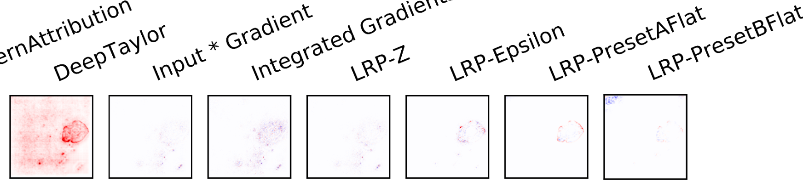

Slide 15
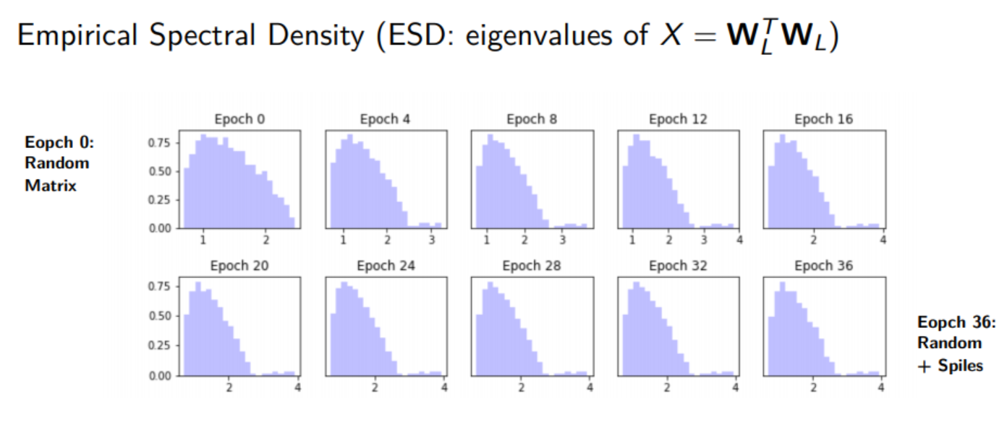
WeightWatcher (PyPI)

Slide 16
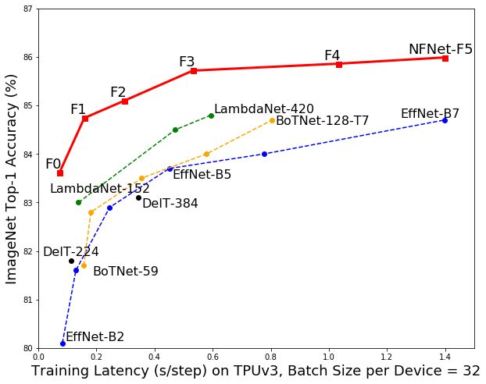
Automatic interpretation of salmon scales using deep learning

Slide 17
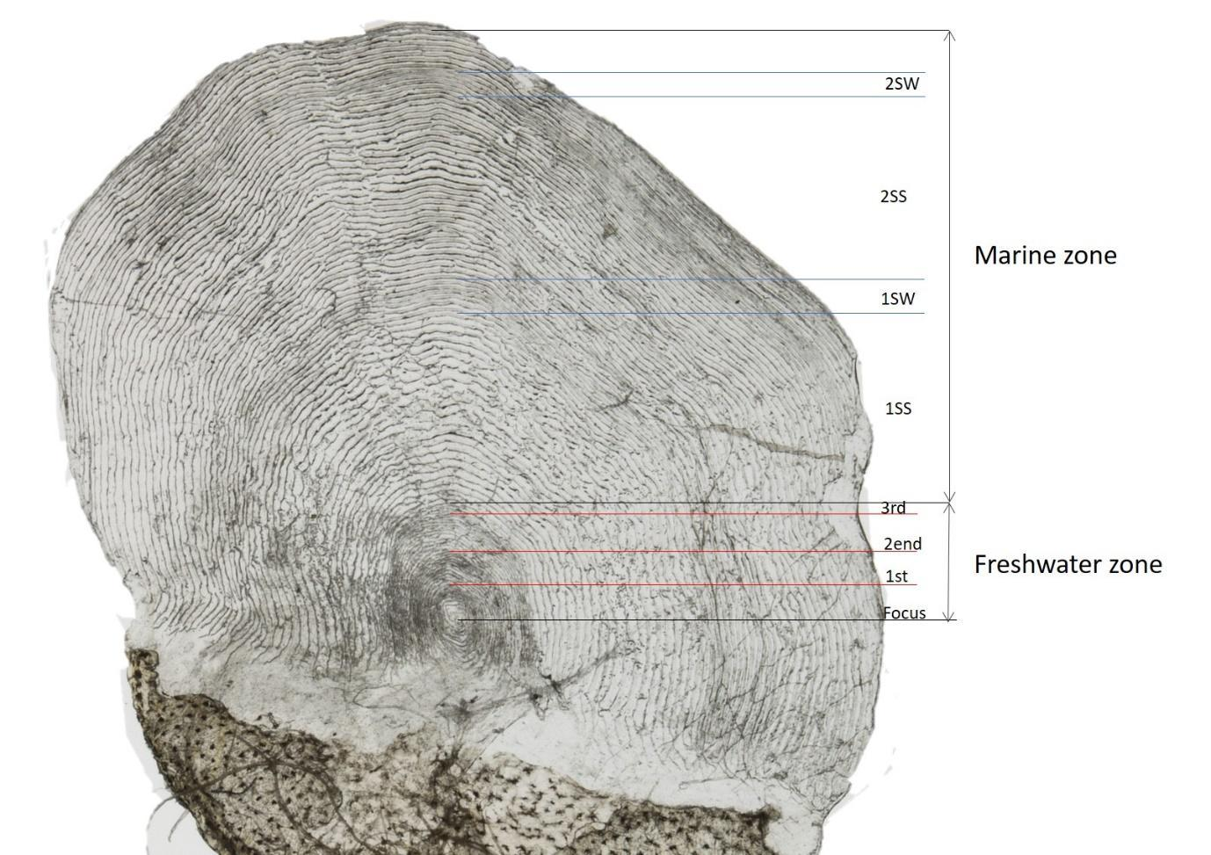

Slide 18
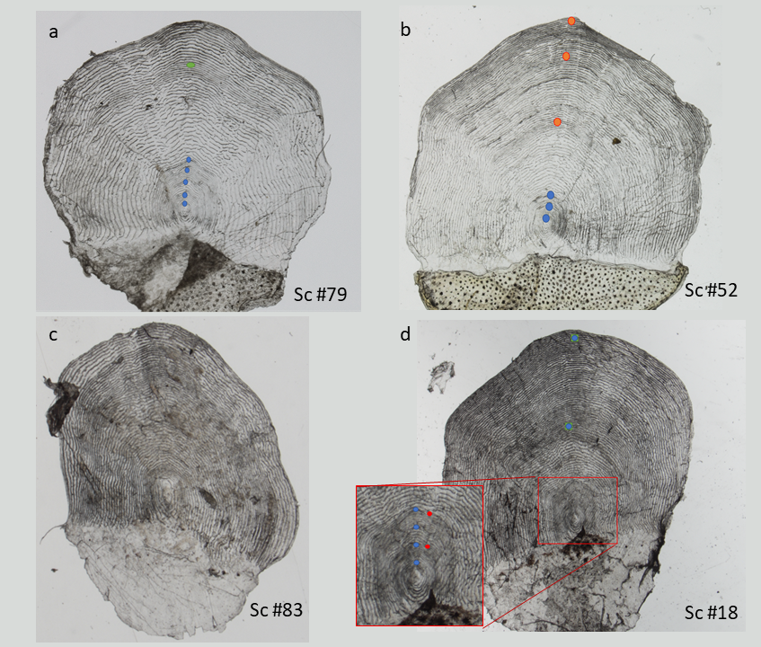

Slide 19
Predicting | Test loss | MSE | MAPE | Acc % | Set size | Weighting classes
River Age | 0.336 | 0.336 | 17.34 | 63.20 | 6238 | –
Sea Age | 0.157 | 0.157 | 8.64 | 86.99 | 8286 | –
Spawning | 0.113 | × | × | 96.40 | 9056 | Non-spawner: 0.5 , Spawner:19
Farmed | 0.187 | × | × | 96.70 | 5919 | Farmed: 5.87, Wild:0.54

Slide 20
6 expert readers
150 images read by 6 experts vs CNN

Slide 21
Estimator | Expert 1 | Expert 2 | Expert 3 | Expert 4 | Expert 5 | Expert 6 | CNN
MSE River | 0.121 | 0.145 | 0.130 | 0.133 | 0.125 | 0.159 | 0.219
CV River | 4.19 | 4.70 | 6.32 | 4.78 | 4.31 | 7.04 | 8.97
PA River | 84.68 | 80.31 | 76.42 | 80.74 | 81.20 | 73.72 | 66.00
MSE Sea | 0.068 | 0.050 | 0.033 | 0.098 | 0.051 | 0.059 | 0.058
CV Sea | 2.75 | 2.64 | 0.84 | 3.9 | 2.01 | 2.08 | 1.87
PA Sea | 89.86 | 91.28 | 97.30 | 87.25 | 93.33 | 93.96 | 94.00

Slide 22
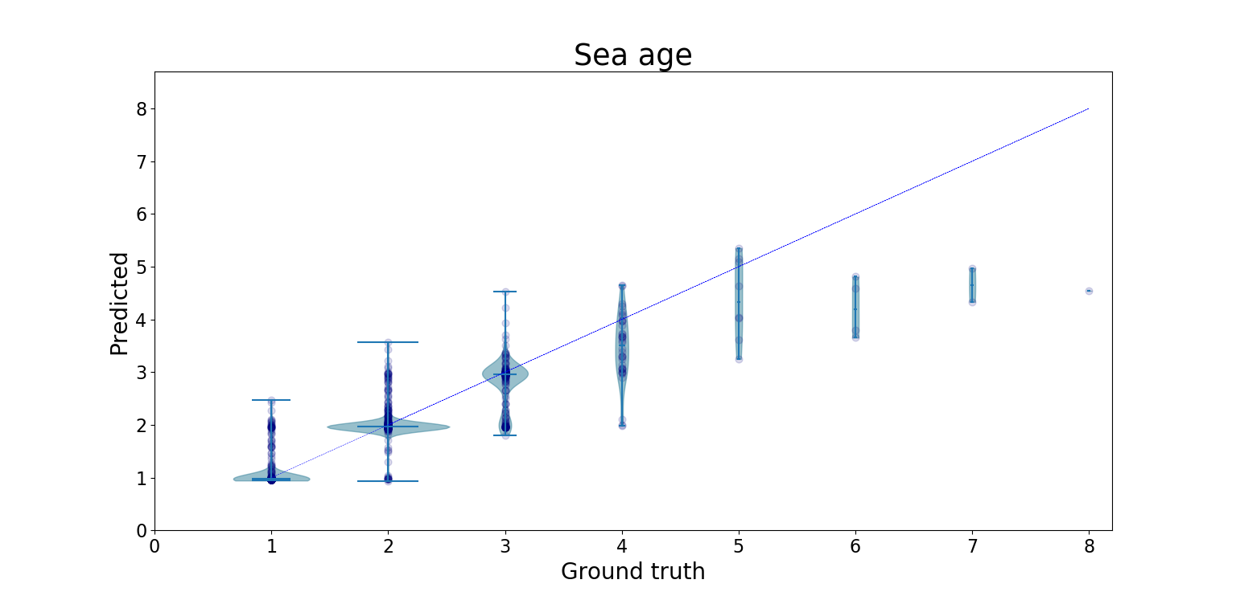

Slide 23
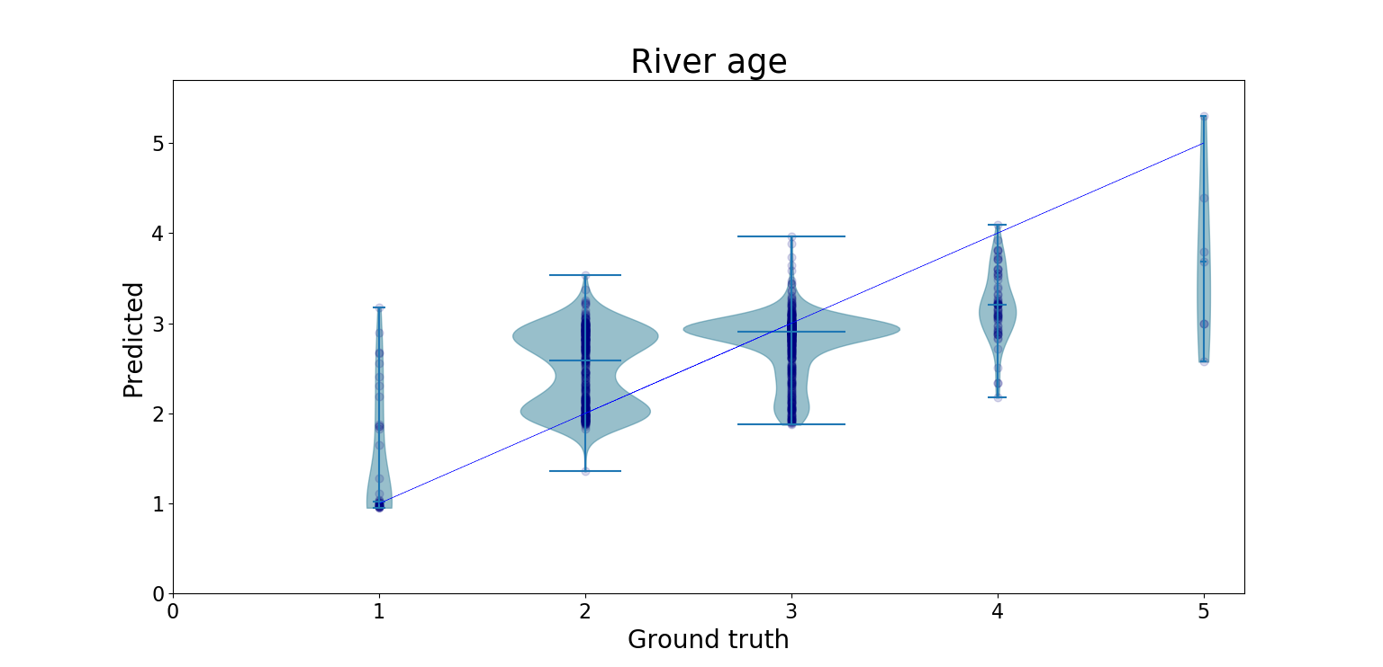

Slide 24
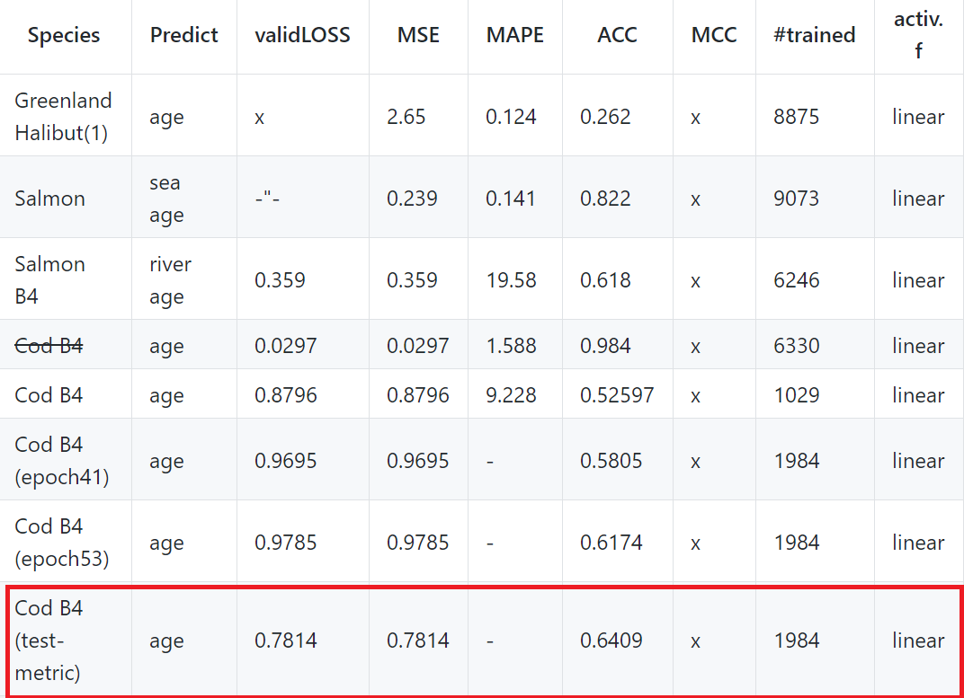
Deep-learning-for-regression-of-cod-otoliths

Slide 25
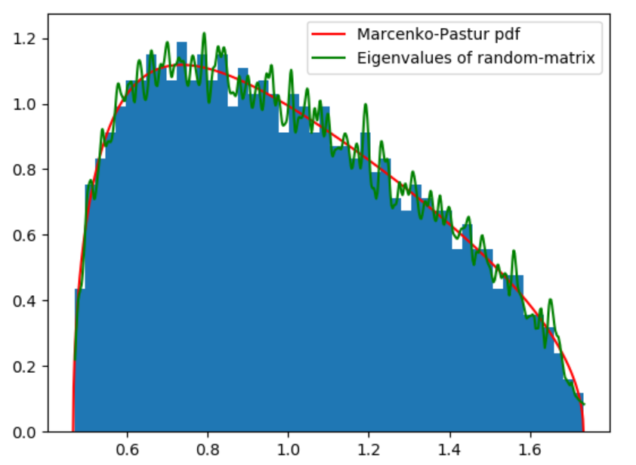
Clustering of family of dependent time-series

Slide 26
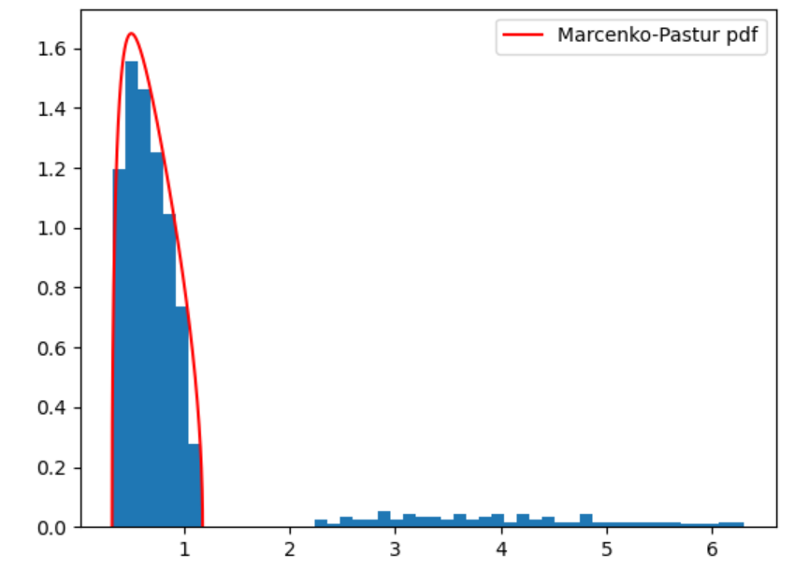

Slide 27
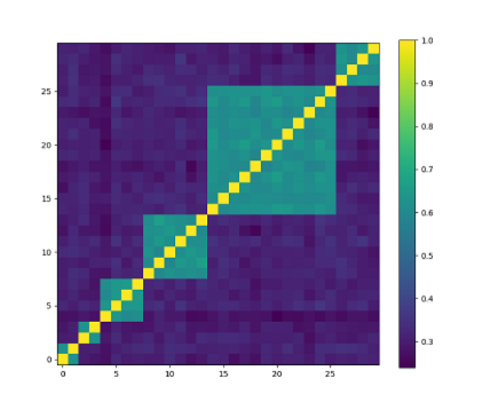
Cluster the correlation matrix to find correlated time-series

Slide 28
